Slide 1
Classes and Objects

Slide 2
Inheritance
Destructors
Properties
Indexers
Garbage Collector

Slide 3
Destructors
Destructors are used to destroy an instances of a class
A class can only have one destructor
Destructors cannot be overloaded
Destructors cannot be called. They are invoked automatically
A Destructor does not take modifiers or have parameters
Notes:
You can force the garbage collector to do clean up by calling the GC. Collect method, but in most cases, this should be avoided because it may result in performance issues.

Slide 4
Destructors
Declaration:
Class Myclass
{
~ Myclass()
{
// Cleaning up code goes here
}
}

Slide 5
Destructors
Destructor is called by the Garbage Collector
The garbage collector checks for objects that are no longer in use
It considers these objects eligible for destruction and reclaims their memory
Destructors are also called when the program exits
Notes:
The IDisposable interface contains only one public method with signature void Dispose(). We can implement this method to close or release unmanaged resources such as files, streams, and handles held by an instance of the class that implements this interface.

Slide 6
Properties
A property is a member function of a class
Property can read and write the private data members from out side of the class
Property declaration comes with 2 accessors
Notes:
properties are an integral part of the C# programming language.
In C#, properties are nothing but natural extension of data fields. They are usually known as 'smart fields' in C# community.
We know that data encapsulation and hiding are the two fundamental characteristics of any object oriented programming language.
In C#, data encapsulation is possible through either classes or structures. By using various access modifiers like private, public, protected, internal etc it is possible to control the accessibility of the class members.
Usually inside a class, we declare a data field as private and will provide a set of public SET and GET methods to access the data fields. This is a good programming practice, since the data fields are not direct

Slide 7
Properties
Declaration:
Access specifier return_type property_name
{
get
{ //get values form a variable
return variable; get accessor
}
set
{ //set values to private var
variable=value; set accessor
}
}
Note: return_type of property and variable type should be same

Slide 8
Properties
class A
{
private int Empid;
public int Id
{
get
{
return Empid;
}
set
{
Empid =value;
}
}
A obj=new A();
obj.Id=1000 set accessor executes
int a1=obj.Id get accessor executes
Notes:
In the Above example 1000 is assigned to Empid field using Id property.

Slide 9
Types Of Properties
Read –Write Property
Having get and set accessors
Read only Property
Having only get accessor
Write only Property
Having only set accessor
Notes:
Static Properties
C# also supports static properties, which belongs to the class rather than to the objects of the class. All the rules applicable to a static member are applicable to static properties also.

Slide 10
Properties contd…
public int Id
{
get
{
return empid;
}
}
public int Id
{
set
{
empid=value
}
}

Slide 11
Indexers
An array elements can be accessed using [] operator
C# also provides a capability to use [] operators on any user-defined classes (or structure)
class FlowerVase{….}
FlowerVase f= new FlowerVase()
f[0]= 12
f[1]= 13
Indexer must be created
Object acts as an array when the class has indexers
Notes:
C# classes can declare indexers to provide array-like access to the classes.
Defining an indexer allows you to create classes that act like "virtual arrays."
Instances of that class can be accessed using the [] array access operator.
Since an indexer is accessed using the [] operator, it does not have a name.

Slide 12
Indexers contd…
Declaration:
public return-type this[int index-position]
{
get { return some-value}
set { some-value= value}
}
indexer name should be this keyword

Slide 13
Indexers
Indexers in C# must have at least one parameter
One parameter indexer are called one dimensional indexers
Two parameter indexers are called two dimensional indexers
Indexers can be overloaded
Indexers can’t be declared as static[static indexers are not supported by c#]
Notes:
Syntax for Declaration:
public type this [type identifier]
Ex : public string this [int myIndex]
Declaring Indexer
public string this[ int myCompanies] { get{
return mycompanies[index] }
set{
} }
Indexers in C# must have at least one parameter else the compiler will generate a compilation error.

Slide 14
Indexers
indexers can be directly accessed with the class object
//to call setaccessor of indexers
object[index]=value;
//to call get accessor
some variable=object[index];

Slide 15
Garbage Collector
Garbage collector is a service of CLR to release unused objects memory from heap
This provides automatic memory management
Notes:
Calling Garbage collector when application requires memory can be considered as an advantage, this will not effect performance of application.[calling garbage collector more number of times into app takes more processor time, this will effects app performance.]
Developer can call Garbage collector explicitly
System.gc.collect()-it will call garbage collector

Slide 16
Garbage Collector
The object which doesn't have reference from an application is called ‘unused object’
GC is a .NET framework thread, which runs when needed
CLR will call garbage collector in 2 cases
When application requires memory
When application is closed

Slide 17
Generations
The garbage collector classifies all objects into three generations (Gens)
Uses three generations to group objects by their lifetime and volatility
Gen 0
Gen 1
Gen 2
Notes:
Gen 0 -Newly created objects. Gen 0 is collected frequently to ensure that short-lived objects are quickly collected and memory is released. Objects that survive a Gen 0 collection are promoted to Gen1
Gen 1 - Collected less frequently than Gen 0 and contains longer-lived objects which were promoted from Gen 0. Objects that survive a Gen 1 collection are promoted to Gen 2
Gen 2 – Objects promoted from Gen 1 (i.e. the longest-lived objects) and collected infrequently. The overall strategy of the garbage collector is to collect and move longer-lived objects less frequently

Slide 18
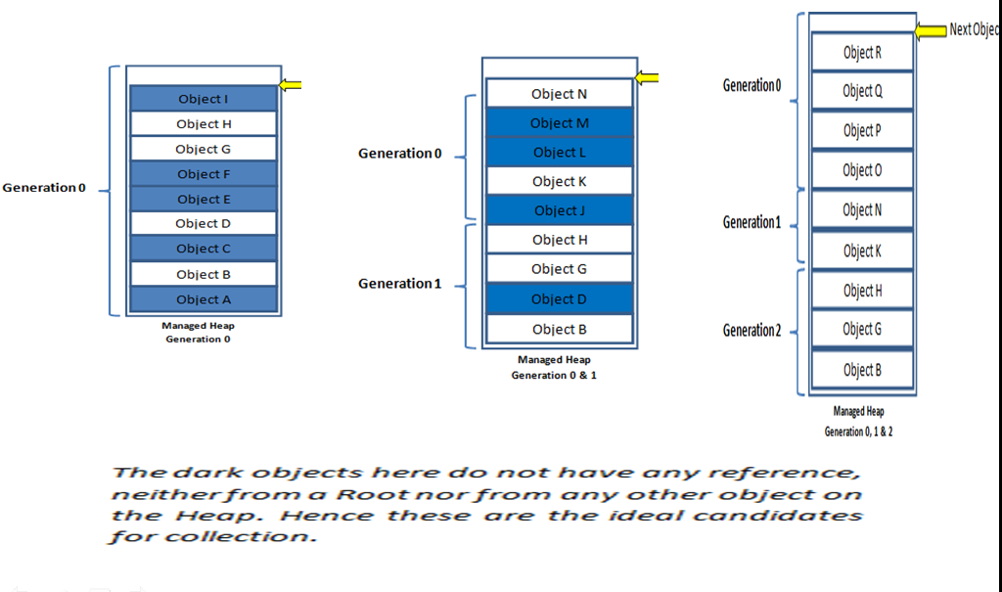
Garbage Collector
Notes:
The garbage collector's optimizing engine determines the best time to perform a collection, based upon the allocations being made. When the garbage collector performs a collection, it checks for objects in the managed heap that are no longer being used by the application and performs the necessary operations to reclaim their memory.

Slide 19
Garbage Collector
Finalize():
The Finalize destructor is a special method
The .NET Framework automatically runs the Finalize() destructor to destroy objects in the memory
CLR periodically check for objects that are not used by the application
Finalize() destructor is called automatically and the garbage collector of the CLR release the object from the memory
Notes:
Finalize () is called by Garbage Collector implicitly to free unmanaged resources. The garbage collector calls this method at some point after there are no longer valid references to the object. There are some resources like windows handles, database connections which cannot be collected by the garbage collector. Therefore the programmer needs to call Dispose() method of IDisposable interface.
Dispose () of IDisposable interface is called by the programmer to explicitly release resources when they are no longer being used. Dispose () can be called even if other references to the object are alive.

Slide 20
Garbage Collector
Dispose():
The Dispose() method is called to release a resource such as database connection
Unlike the Finalize() destructor, the Dispose() method is not called automatically
Called explicitly when an object is no longer needed
The IDisposable interface contains the Dispose() method
Notes:
To call the Dispose() method, the class must implement the IDisposable interface

Slide 21
JAM
1.How do you create a Read only Property in C#
A.Using Only Get accessor B.Using Only Set C.Using both Get and Set
A. A
2.Garbage collection-----------
A. reclaims the unused object B.using the unused object
A. A
3.How do you call garbage collector__________
A. GC.Collect()
4.can get/set have more than one access specifier in property?
A.Yes B.No C.None
A. A

Slide 22
Inheritance
Notes:
Welcome to Inheritance Concept

Slide 23
Inheritance
Define inheritance
Need for Inheritance
Base and Child class
Multiple constructors
Use “base” keyword
Notes:
These are the Topics we are going to discuss.

Slide 24
Inheritance
Enables you to extend the functionality of the existing class
Enables you to add new features and functionality to an existing class without modifying the existing class
Enables you to share data and methods among multiple class
Notes:
Inheritance concept talks about Reusability.

Slide 25
Inheritance
A base class or parent class is the one from which another class inherits attributes and behavior
A derived class or child class is a class that inherits attributes and behaviors from a base class
Notes:
In Inheritance we have both base class and child class. Base class is also known as Super class or parent class and childclass is also know as sub class or derived class.

Slide 26
Inheritance
Class: Air Ticket Attributes: Flight Number Date Time Destination
Class: Confirmed Ticket Inherited Attributes: Flight Number Date Time Destination Own Attribute: Seat No:
Class: Requested Ticket Inherited Attributes: Flight Number Date Time Destination Own Attribute: Status:
Notes:
Air Ticket is a class which is having commonalities of both Confirmed Ticket and Requested Ticket.

Slide 27
Relationships
Is-a
Has-a
Notes:
We have two types of Relationships :
1.Is -a Relationship
2. Has-a Relationship

Slide 28
Is-a Relationship
Relationship between objects of super class and subclass is referred to as an is-a relationship
A subclass always inherits the attributes of the super class
Confirmed Ticket
Ticket
Is-a

Slide 29
Is-a Relationship contd…
The is-a relationship between the Clean wash class and Washing Machine class
Clean wash
Washing
machine
Is-a

Slide 30
Has-a Relationship
The has-a relationship is also known as aggregation or composition
Student-detail
Address
Has-a

Slide 31
Has-a Relationship contd..
A washing machine has a spinner and depicts the has-a relationship between the washing Machine and Color class
Washing Machine
Color
Has-a

Slide 32
Inheritance contd…
Single inheritance
Multiple inheritance

Slide 33
Single Inheritance
Single inheritance - Child class is derived from only one base class

Slide 34
Single Inheritance
Base Class
(parent)
Derived class
(child)

Slide 35
Single Inheritance contd…
Numerals
Even Numbers
Odd Numbers
Prime Numbers
Notes:
Numerals is a parent class and even ,odd, prime Numbers are child classes of Numerals.

Slide 36
Multiple Inheritance
Multiple inheritance - Class s is derived from more than one super class
Base class(parent-1)
Base class(parent-2)
Derived class(child)
Notes:
If a class is derived from two or more classes this concept is called Multiple Inheritance.

Slide 37
Inheritance contd…
The inherited attributes can be used directly just like any other attributes
new attributes can be declared in the child class that are not in the base class
Private members cannot be inherited in to childclass
Notes:
Whatever the parent class is having i.e available to the child class except private members.
A subclass does not inherit the private members of its parent class. However, if the super class has public or protected methods for accessing its private fields, these can also be applied by the subclass

Slide 38
Inheritance contd…
The inherited methods can be used directly
New methods can be declared in the subclass that are not in the base class
Notes:
You can Inherit methods which are present in parent class in to child class.And subsequently you can add extra methods in to your child class.

Slide 39
Inheritance
class Car{ String name; public Car(){ name=“My First Car”; } public Car(String name ){ this.name=name; } }
Refers to the current object
Notes:
This key word differentiates local variables and instance variables.

Slide 40
Inheritance
Is a reference to the current object within an instance method or constructor
Explicit constructor invocation -- call another constructor in the same class
Notes:
By using this() you can invoke another constructor which is available in the same class. But we cannot make constructor calling inside a method . It leads to compile time error.

Slide 41
Inheritance
public MyClass(int a, int b) :this(0, 0, a, b)
{
}
public MyClass(int x, int y, int a, int b) {
this.x = x;
this.y = y;
this.a = a;
this.b = b;
} } ...
public class MyClass {
private int x, y, a, b;
public MyClass():this(0, 0, 0, 0)
{
}

Slide 42
Inheritance contd…
class A { int a1,a2,a3; public A(int m1, int m2, int m3){ a1 = m1; a2 = m2; a3 = m3; } } class B extends A { int a4,a5; public B(int x1, int x2, int x3, int x4, int x5) { a1=x1; a2=x2; a3=x3; a4=x4; a5=x5; } }
class B extends A{
int a4,a5;
public B(intx1,intx2,intx3,
intx4,intx5): base(x1,x2,x3)
{
a4=x4;
a5=x5;
}
}
Calls the base class constructor
Notes:
Super() is used to initialize child class properties in parent class constructor.

Slide 43
Inheritance
A child class will call base class constructor by
using base keyword
A child class constructor invokes the constructor of the baseclass implicitly
Notes:
When an object of the Student class (subclass) is instantiated, the default constructor of its base class i.e. Person, is invoked implicitly before the statements in the constructor method of the derivedclass are executed

Slide 44
JAM
1.Why Inheritance
A.Inheritance leads to code reusability
2.Types of Inheritance
A.Single Inheritance , Multilevel Inheritance,Multiple Inheritance ,Hybrid Inheritance
3.Does C# Supports Multiple Inheritance
A.No
4.How to call the Base Constructor in Derived Class
A.Using base keyword

Slide 45
Quiz
1.Does C# support multiple inheritance?
A.Yes B.No C.Some Times
A.B
2.What’s the top .NET class that everything is derived from?
A.System.String B.StringBuilder C.System.Object D.Text.String
A. C
3.The combination of Multiple & Multilevel Inheritance is called
A.Hyrorchical Inheritance B.Hybrid Inheritance C.Both
A .A

